Slide 1

OBJECT DETECTION IN REAL TIME USING CAMERA ALONG WITH METAL DETECTOR

Slide 2


GROUP MEMBERS
SANDADI NEERAJA
20MI10055
SANSKRITI
20MI31018
VIDYASAGAR
20MI3FP22
LOHITYA WASNIK
20MI10030

Slide 3
CONTENTS
Team Contribution | 1
Weekly Analysis | 2-3
Introduction | 4
Arduino NANO | 5
Breadboard | 6
Jumper Wires | 7
220 ohm and 330 ohm Resistors | 8
1N418 Diode | 9
5m Copper Wire | 10

Slide 4
Red Light LED | 11
10nf Capacitor | 12
Buzzer | 13
Working of Metal Detector | 14-15
Circuit Diagram | 16
Programming | 17-22
Wiring of Real Hardware | 23
Object Detection Model | 24
Conclusion and Future Prospects | 25

Slide 5
TEAM CONTRIBUTION
1
SOFTWARE
HARDWARE
Vidyasagar and Sandadi Neeraja
Sanskriti and Lohitya

Slide 6
WEEKLY ANALYSIS
2
WEEK 1
Selection of topic for group project.
WEEK 2
Developing program for Metal detector.
Collecting information for metal detector.
Linking code with Arduino NANO.
Buying of all components required for the project.

Slide 7
3
WEEK 3
Developing Object detection Model.
WEEK 4
Testing the working of metal detector.
Preparation of presentation.

Slide 8
INTRODUCTION
4
Object detection in real life using cameras and metal detectors is a powerful technology that is widely used for security and safety purposes. It involves using a camera to capture real-time images of an area, which are then analyzed by an object detection algorithm to identify any objects of interest. At the same time, a metal detector can be used to detect metallic objects that may be hidden or concealed from view. When combined, these two technologies provide a powerful tool for identifying potential threats, such as weapons or other dangerous objects. In addition to security applications, object detection using a camera and metal detector can also be used in industrial settings, such as mining and construction, to identify hazards and potential safety risks. Overall, object detection technology is a crucial component of modern safety and security systems and continues to play an important role in ensuring public safety.. Metal detectors aid in detecting and preventing accidents caused by metal items, such as tools or debris, which can cause injuries or damage to equipment. Metal detectors may also detect valuable minerals such as gold or copper and protect equipment by removing large metal fragments that may have fallen into machinery. Furthermore, metal detectors are utilized to find unexploded munitions, assuring worker and community safety. Coal mines also use metal detectors to identify metal debris and avoid accidents caused by hidden metal items. Mining businesses can safeguard the security of their personnel and equipment, enhance productivity, and locate lucrative minerals by utilizing metal detectors.

Slide 9
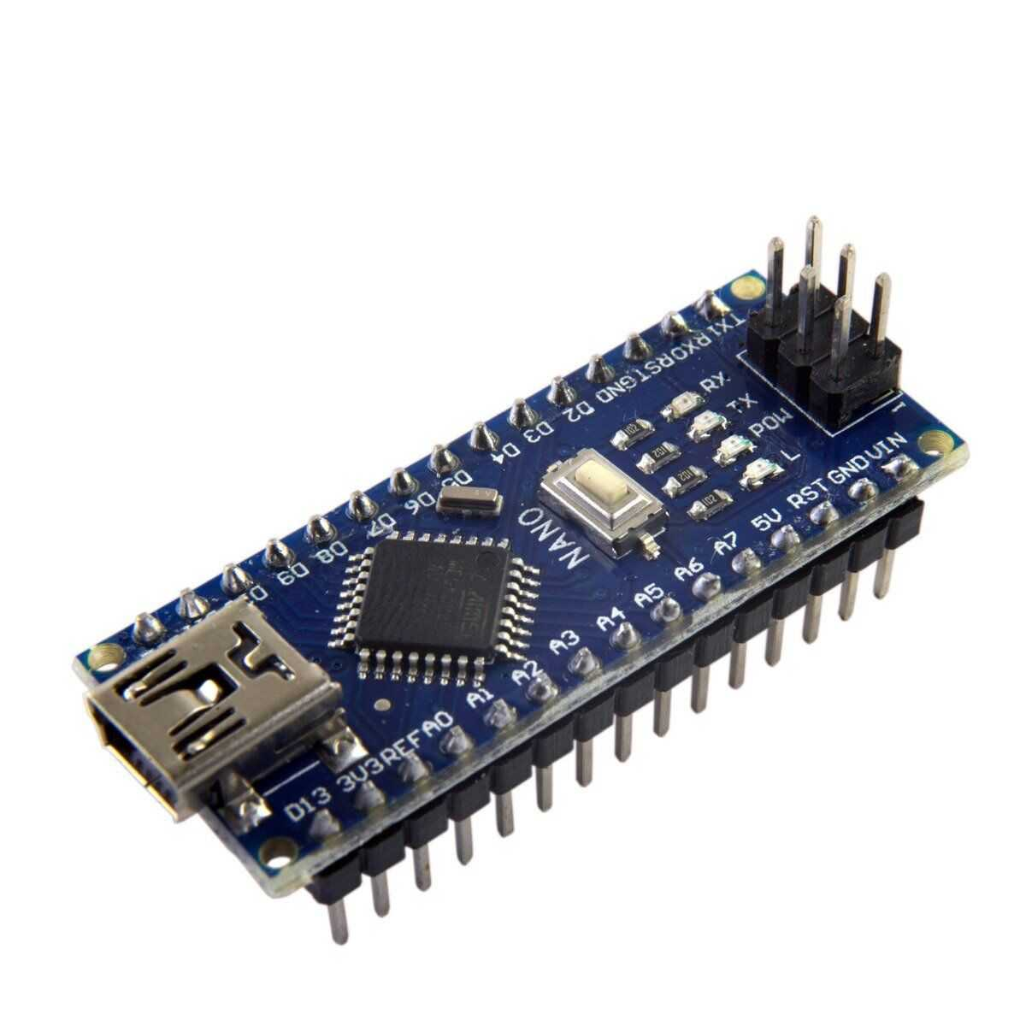
ARDUINO NANO
5
The Arduino Nano is a compact and versatile development board designed for hobbyists, students, and professionals alike. It is based on the ATmega328P microcontroller, which is the same chip used in the popular Arduino Uno. However, the Nano is significantly smaller in size and has a lower power consumption. It is equipped with 14 digital input/output pins, 8 analog inputs, and a USB interface for programming and communication. Its compact size and ease of use make it a popular choice for a wide range of projects, including robotics, automation, and IoT applications.

Slide 10
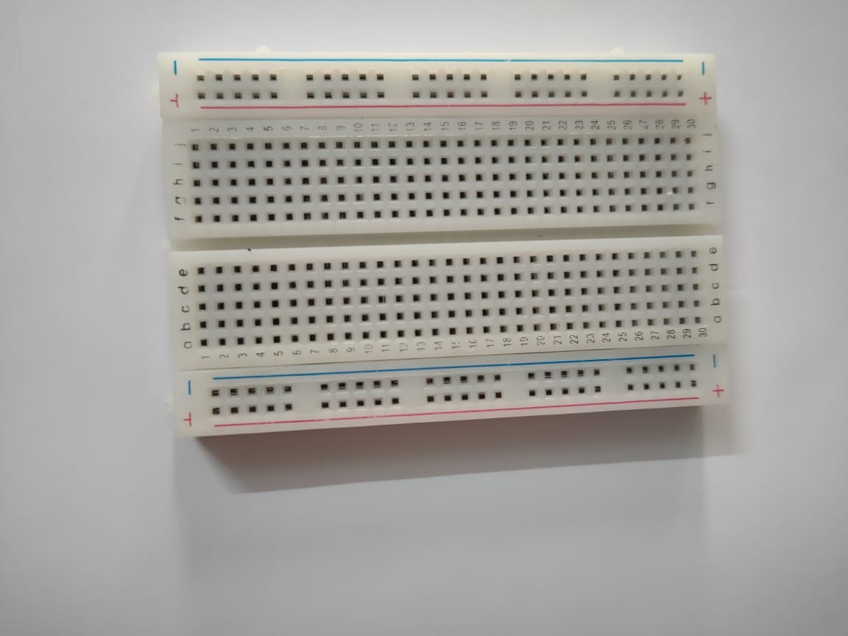
BREADBOARD
6
Breadboard is solderless device on which we make a temporary prototype device with electronic and test circuit design. Since the it is solderless device i.e., it does not require any soldering to connect the components, and this is one of the main reasons to use breadboard to make a prototype.

Slide 11
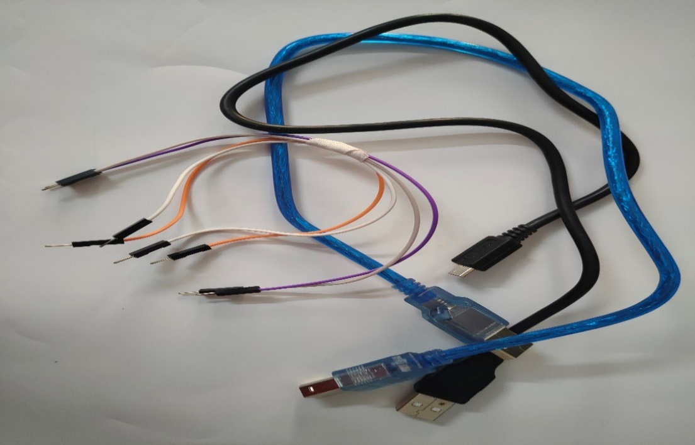
JUMPER WIRES
7
Jumper wire are the group of wire which are join in a form of a cable and each wire contain pin or connector at both the end. This type of wire is used to create prototype of any device because this wire does not require any type of soldering.

Slide 12
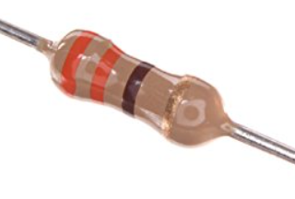
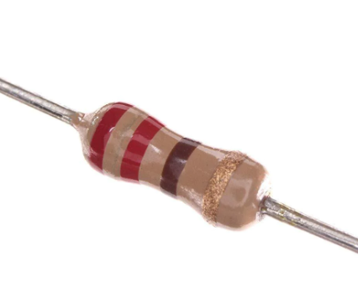
220 ohm and 330 ohm RESISTORS
8
330 ohm
220 ohm
Resistors are one of the most commonly used passive electronic components, designed to restrict or limit the flow of current in an electrical circuit. They are available in different types including carbon film, metal film, wire wound, and surface mount resistors. Resistors are measured in ohms, with values ranging from a few ohms to several megaohms. They are used in a wide variety of electronic applications such as voltage dividers, current limiters, and timing circuits. In addition to their use in electronic circuits, resistors are also used in sensors, heaters, and other devices that require precise control of electrical current.

Slide 13
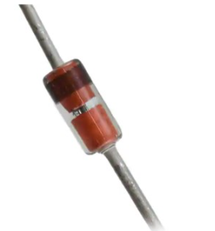
1N418 DIODE
9
The 1N418 diode is a small signal diode that is commonly used in low-power electronic applications. It has a maximum current rating of 50mA and a maximum voltage rating of 75V. This diode is typically used in circuits for rectification, signal detection, and clipping. It features a glass encapsulated construction and is available in a through-hole package, making it easy to use on a breadboard or printed circuit board. With its low cost, small size, and reliable performance, the 1N418 diode is a popular choice for many hobbyist and professional electronic projects.

Slide 14
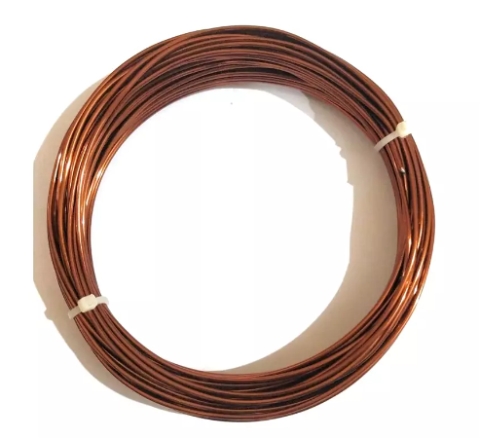
5m COPPER WIRE
10
5m copper wire is a commonly used electrical conductor that is ideal for many applications. It has a diameter of approximately 0.2 mm and can carry a significant amount of electrical current. Copper is a highly conductive metal that is also relatively inexpensive, making it an attractive choice for many projects. Copper wire is widely used in electrical wiring, power transmission, and telecommunications applications. It is also used in various forms of motors, generators, and transformers, as well as in electronic components such as inductors and coils. With its excellent electrical properties and broad range of applications, copper wire remains an essential component of many modern technologies.

Slide 15
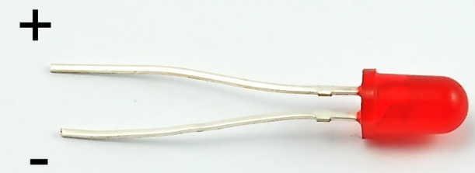
RED LIGHT LED
11
LEDs, or light-emitting diodes, are a type of semiconductor device that emits light when a voltage is applied across its terminals. They are widely used in electronic devices and lighting applications due to their low power consumption, long lifespan, and versatility. LEDs come in a wide range of colors, including red, green, blue, yellow, and white, and can be used in a variety of configurations to create different effects. They are commonly used in automotive lighting, traffic signals, and decorative lighting applications. With their high efficiency and low heat output, LEDs are also increasingly used in indoor and outdoor lighting for homes, offices, and public spaces, making them a popular choice for energy-efficient lighting solutions.

Slide 16
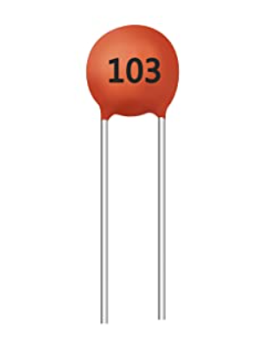
10nf CAPACITOR
12
The 10nf capacitor is a type of ceramic capacitor commonly used in electronic circuits. It has a capacitance value of 10 nanofarads, also expressed as 0.01 microfarads or 10,000 picofarads. These capacitors are typically used for decoupling, filtering, and bypass applications. They are small in size, and can be found in through-hole or surface mount packages. Ceramic capacitors have a wide range of operating temperatures and are relatively stable, making them a popular choice in many electronic circuits. With their high performance and low cost, 10nf capacitors are widely used in various types of electronics from audio equipment to digital devices.

Slide 17
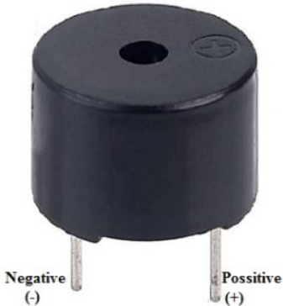
BUZZER
13
A buzzer is an electronic component that produces a continuous or intermittent sound when activated. It is commonly used in alarms, doorbells, and other audible warning systems. Buzzer components come in different types, including magnetic, piezoelectric, and electrostatic buzzers, each with their unique characteristics. Magnetic buzzers are reliable and efficient, piezoelectric buzzers are compact and lightweight, while electrostatic buzzers are suitable for low voltage applications. The sound produced by buzzers can also be customized by varying the input voltage or frequency, making them ideal for a range of applications that require different sound levels and tones. With their low cost, easy-to-use features, and reliability, buzzers are a widely used component in various electronic circuits.

Slide 18
WORKING OF METAL DETECTOR
14
Whenever some current passes through the coil, it generates a magnetic field around it. And the change in the magnetic field generates an electric field. Now according to Faraday's law, because of this Electric field, a voltage develops across the coil which opposes the change in magnetic field and that’s how Coil develops the Inductance, means the generated voltage opposes the increase in the current. When any metal comes near to the coil then coil changes its inductance. This change in inductance depends upon the metal type. It's decreases for non-magnetic metal and increases for ferromagnetic materials like iron. Depending on the core of the coil, inductance value changes drastically. In the figure below you can see the air-cored inductors, in these inductors, there will be no solid core. They are basically coils left in the air. The medium of flow of magnetic field generated by the inductor is nothing or air. These inductors have inductances of very less value. These inductors are used when the need for values of few microHenry. For values greater than few milliHenry these are not a suitable one. In below figure you can see an inductor with ferrite core. These Ferrite Core inductor has very large inductance value. Remember the coil wound here is air co-

Slide 19
15
red one, so when a metal piece is brought near the coil, the metal piece acts as a core for the air cored inductor. By this metal acting as a core, the inductance of the coil changes or increases considerably. With this sudden increase in inductance of coil the overall reactance or impedance of the LC circuit changes by a considerable amount when compared without the metal piece. So here in this Arduino Metal Detector Project, we have to find the inductance of the coil to detect metals. So to do this we have used LR circuit (Resistor-Inductor Circuit) that we already mentioned. Here in this circuit, we have used a coil having around 20 turns or winding with a 10cm diameter.

Slide 20
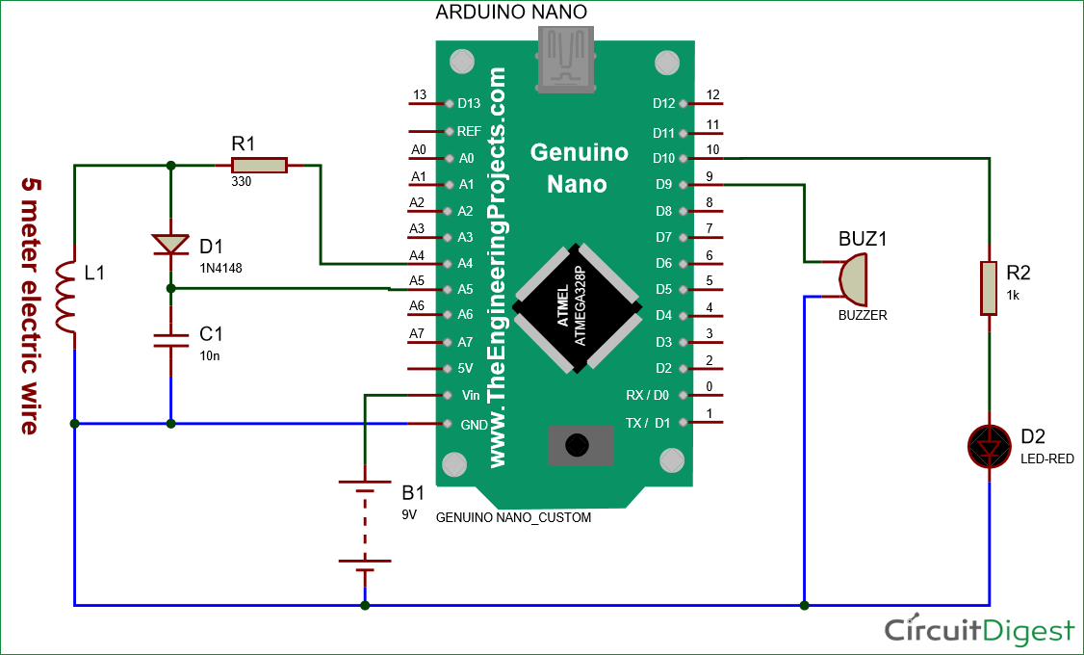
CIRCUIT DIAGRAM
16

Slide 21
PROGRAMMING
17
ARDUINO CODE:
#define capPin A5
#define buz 9
#define pulsePin A4
#define led 10
long sumExpect=0; //running sum of 64 sums
long ignor=0; //number of ignored sums
long diff=0; //difference between sum and avgsum
long pTime=0;
long buzPeriod=0;
void setup()
{

Slide 22
18
Serial.begin(9600);
pinMode(pulsePin, OUTPUT);
digitalWrite(pulsePin, LOW);
pinMode(capPin, INPUT);
pinMode(buz, OUTPUT);
digitalWrite(buz, LOW);
pinMode(led, OUTPUT);
}
void loop()
{
int minval=1023;
int maxval=0;
long unsigned int sum=0;
for (int i=0; i<256; i++)
{
//reset the capacitor

Slide 23
19
pinMode(capPin,OUTPUT);
digitalWrite(capPin,LOW);
delayMicroseconds(20);
pinMode(capPin,INPUT);
applyPulses();
//read the charge of capacitor
int val = analogRead(capPin); //takes 13x8=104 microseconds
minval = min(val,minval);
maxval = max(val,maxval);
sum+=val;
long unsigned int cTime=millis();
char buzState=0;
if (cTime<pTime+10) { if (diff>0)
buzState=1;
else if(diff<0) buzState=2; } if (cTime>pTime+buzPeriod)
{
if (diff>0)

Slide 24
20
buzState=1;
else if (diff<0) buzState=2; pTime=cTime; } if (buzPeriod>300)
buzState=0;
if (buzState==0)
{
digitalWrite(led, LOW);
noTone(buz);
}
else if (buzState==1)
{
tone(buz,100);
digitalWrite(led, HIGH);
}
else if (buzState==2)
{
tone(buz,500);

Slide 25
21
digitalWrite(led, HIGH);
}
})
//subtract minimum and maximum value to remove spikes
sum-=minval;
sum-=maxval;
if (sumExpect==0)
sumExpect=sum<<6; //set sumExpect to expected value
long int avgsum=(sumExpect+32)>>6;
diff=sum-avgsum;
if (abs(diff)>10)
{
sumExpect=sumExpect+sum-avgsum;
ignor=0;
}
else
Ignor++;
if (ignor>64)
{

Slide 26
22
sumExpect=sum<<6;
ignor=0;
}
if (diff==0)
buzPeriod=1000000;
else
buzPeriod=avgsum/(2*abs(diff));
}
void applyPulses()
{
for (int i=0;i<3;i++)
{
digitalWrite(pulsePin,HIGH); //take 3.5 uS
delayMicroseconds(3);
digitalWrite(pulsePin,LOW); //take 3.5 uS
delayMicroseconds(3);
}
}

Slide 27
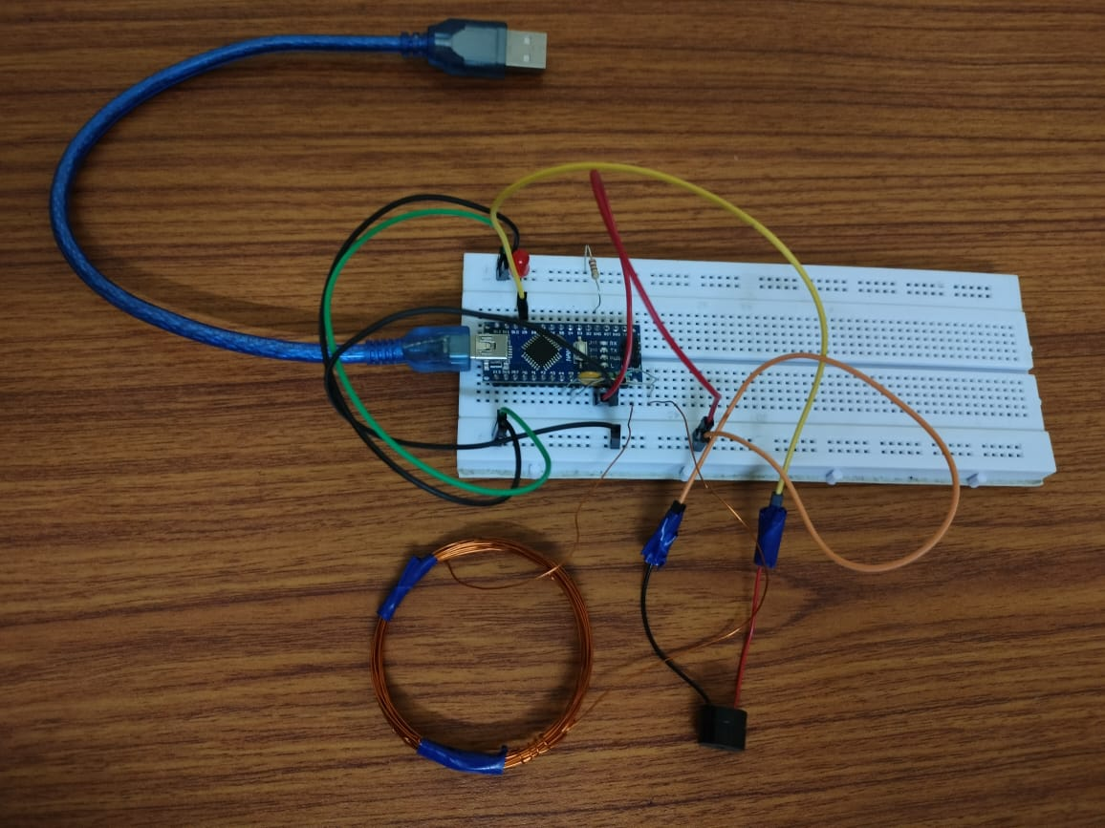
WIRING OF REAL HARDWARE
23

Slide 28
OBJECT DETECTION MODEL
24
https://colab.research.google.com/drive/1vKbZrJo08DCUqmgKIPas-9e_snyxD9hw?usp=sharing

Slide 29
COCLUSION AND FUTURE PROSPECTS
25
Object detection in real-time using a camera along with a metal detector has the potential to be a valuable technology for a variety of applications. Here are some possible future prospects for this technology:
Security applications: One of the most obvious uses for object detection with a metal detector is in security applications, such as screening people or baggage at airports or other high-security locations. Real-time object detection using cameras and metal detectors could help security personnel quickly identify potentially dangerous objects, such as guns or knives, and take appropriate action.
Industrial applications: Object detection using cameras and metal detectors could be useful in industrial settings, such as manufacturing facilities, to ensure that workers are not carrying any metal objects that could interfere with machinery or cause accidents.
Mining and construction: Metal detectors are already commonly used in mining and construction to detect buried metal objects, but combining them with real-time object detection using cameras could make the process faster and more efficient.
Archaeology and treasure hunting: Object detection using cameras and metal detectors could be useful in archaeological excavations and treasure hunting, helping researchers locate and identify valuable artifacts.
Sports and entertainment: Real-time object detection using cameras and metal detectors could be used in sports and entertainment venues to detect and prevent fans from bringing in prohibited items, such as weapons or alcohol.
Overall, the future prospects for object detection in real-time using a camera along with a metal detector are promising, with potential applications in a variety of fields.

Slide 30
THANK YOU

